Slide 1
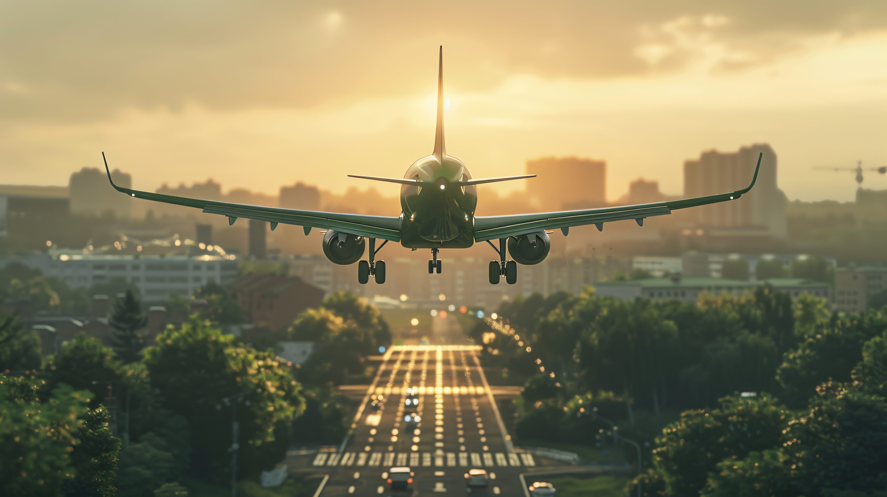
Flight Price Prediction
Data Analysis & Insights
March - June 2019 | Indian Flight Routes

Slide 2
Flight Price Prediction
Data Analysis & Insights
March - June 2019 | Indian Flight Routes

Slide 3
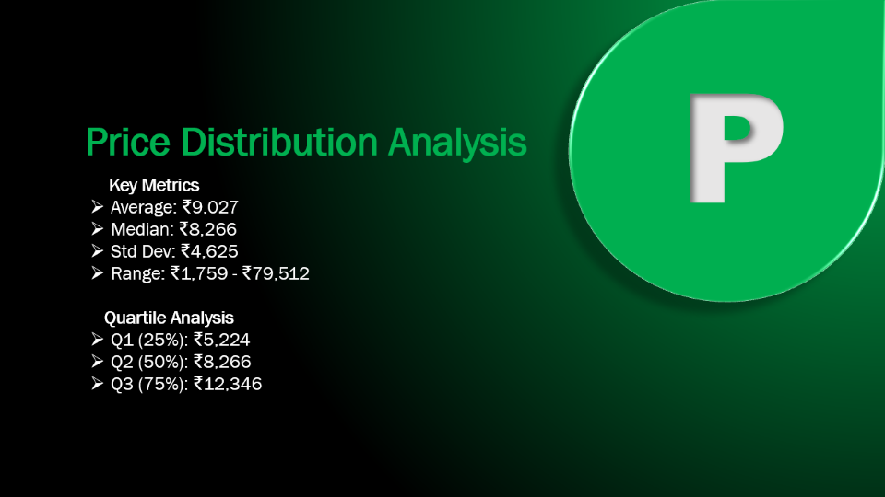
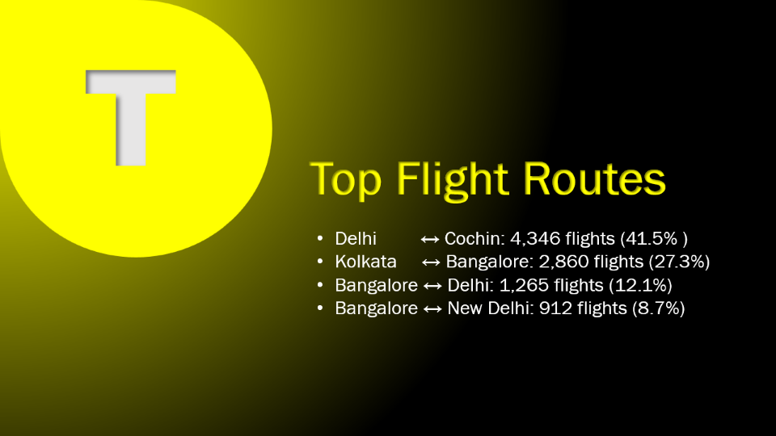
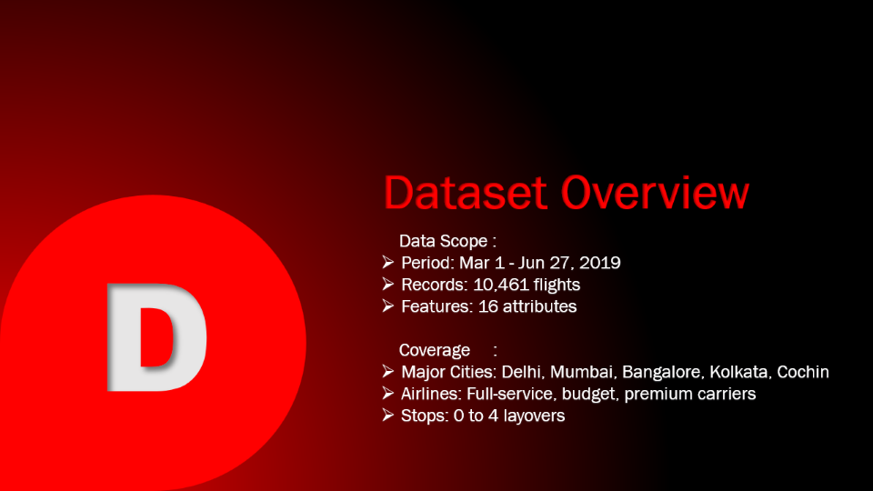
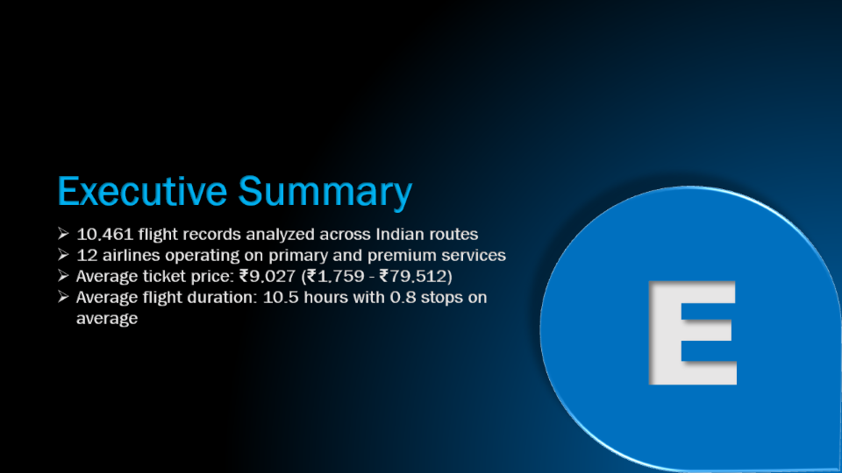
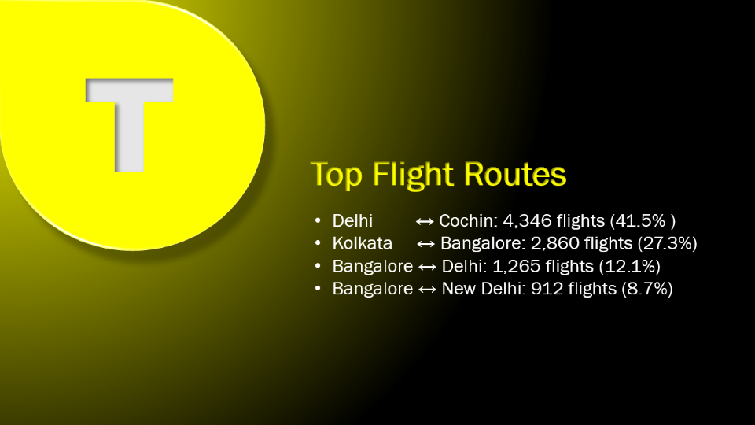
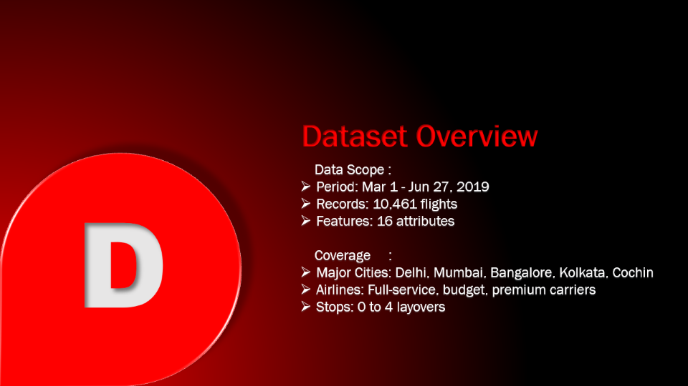
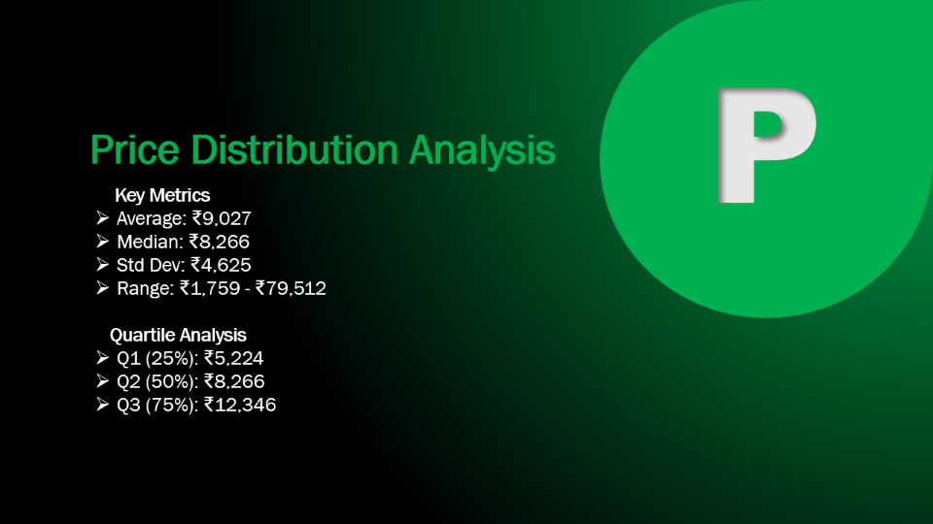
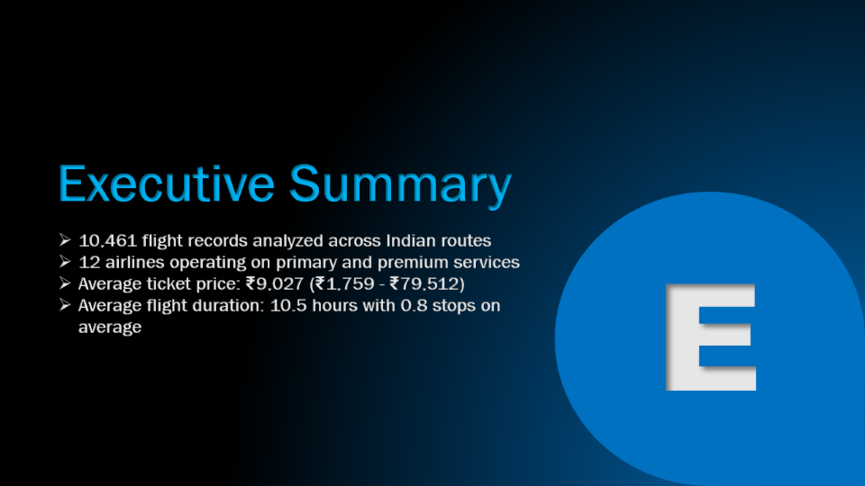

Slide 4
Executive Summary
10,461 flight records analyzed across Indian routes
12 airlines operating on primary and premium services
Average ticket price: ₹9,027 (₹1,759 - ₹79,512)
Average flight duration: 10.5 hours with 0.8 stops on average
E

Slide 5
Dataset Overview
Data Scope :
Period: Mar 1 - Jun 27, 2019
Records: 10,461 flights
Features: 16 attributes
Coverage :
Major Cities: Delhi, Mumbai, Bangalore, Kolkata, Cochin
Airlines: Full-service, budget, premium carriers
Stops: 0 to 4 layovers
D

Slide 6
P
Price Distribution Analysis
Key Metrics
Average: ₹9,027
Median: ₹8,266
Std Dev: ₹4,625
Range: ₹1,759 - ₹79,512
Quartile Analysis
Q1 (25%): ₹5,224
Q2 (50%): ₹8,266
Q3 (75%): ₹12,346

Slide 7
T
Top Flight Routes
Delhi ↔ Cochin: 4,346 flights (41.5% )
Kolkata ↔ Bangalore: 2,860 flights (27.3%)
Bangalore ↔ Delhi: 1,265 flights (12.1%)
Bangalore ↔ New Delhi: 912 flights (8.7%)

Slide 8

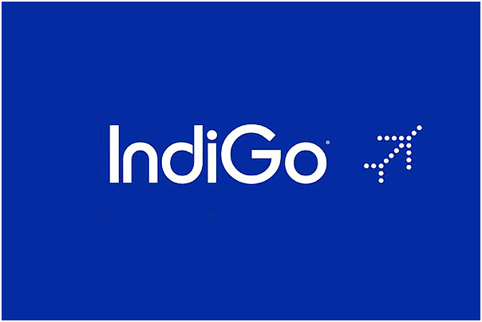
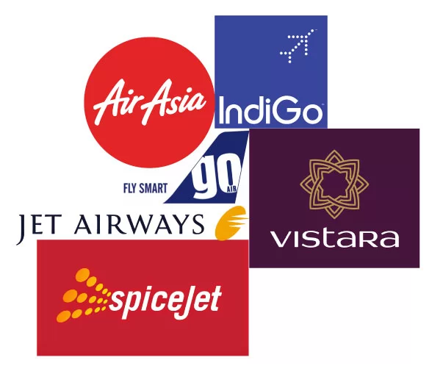

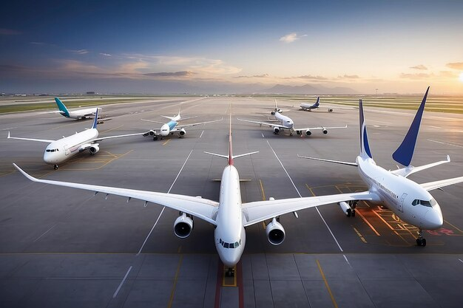
Airline Distribution Volume
Jet Airways
Jet Airways is the most popular airline in the dataset with 3,700 flights recorded. The average ticket price is ₹11,599, ranging from ₹1,840 to ₹54,826. Most flights have approximately 1 stop with an average journey duration of 13.8 hours. The busiest routes are Delhi to Cochin (1,438 flights) and Kolkata to Bangalore (1,256 flights). Jet Airways offers both economy and business class services.

Slide 9
Airline Distribution Volume
IndiGo
IndiGo is the second-largest carrier with 2,043 flights and offers budget-friendly fares. The average price is ₹5,668, making it one of the most affordable options with prices between ₹2,227 and ₹22,153. Most IndiGo flights are direct or have minimal stops (0.41 average) with shorter durations of about 4.8 hours. The airline primarily operates on Delhi-Cochin, Kolkata-Bangalore, and Bangalore-Delhi routes. IndiGo focuses on quick, efficient travel with shorter flight times.

Slide 10
Airline Distribution Volume
Air India
Air India operates 1,695 flights with an average ticket price of ₹9,555. Prices range from ₹2,050 to ₹31,945 across various routes and service classes. Flights typically have 1.21 stops on average with the longest average duration of 15.5 hours. The main routes include Delhi-Cochin (704 flights) and Kolkata-Bangalore (501 flights). Air India serves both domestic and connecting routes with moderate pricing.

Slide 11
Airline Distribution Volume
Multiple Carriers
Multiple Carriers represents flights operated by airline partnerships with 1,196 total flights. The average fare is ₹10,903, ranging from ₹5,797 to ₹36,983. These flights average about 1 stop with journey durations around 10.4 hours. Interestingly, all flights exclusively operate on the Delhi to Cochin route. This category includes both regular and premium economy options.

Slide 12
Airline Distribution Volume
Other Airlines
1,827 flights (17.5%) - SpiceJet, Vistara, Air Asia, GoAir Budget carriers like SpiceJet (815 flights, ₹4,336 average) and Air Asia (318 flights, ₹5,594 average) offer affordable options, while premium services include Jet Airways Business (₹58,359 average) and Vistara Premium Economy. Mid-range carriers Air India (1,695 flights), Vistara (477 flights), and GoAir (194 flights) balance price and service, with Multiple Carriers operating 1,196 flights on shared routes. The price range spans from ₹1,759 (SpiceJet) to ₹79,512 (Jet Airways Business),

Slide 13

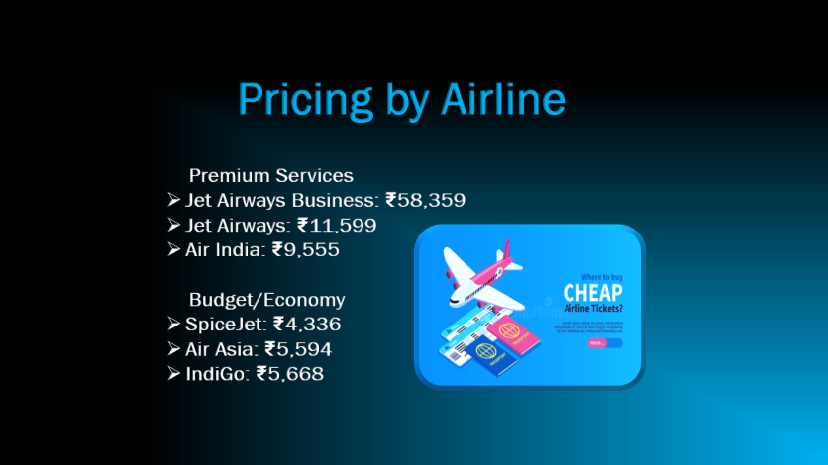
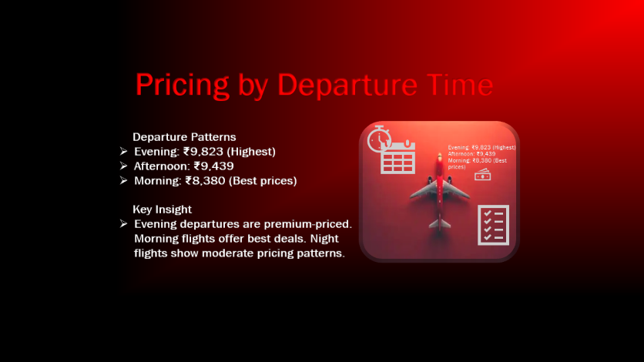
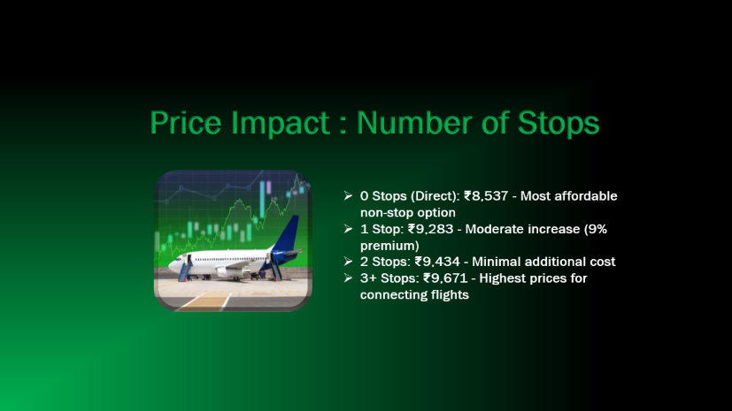
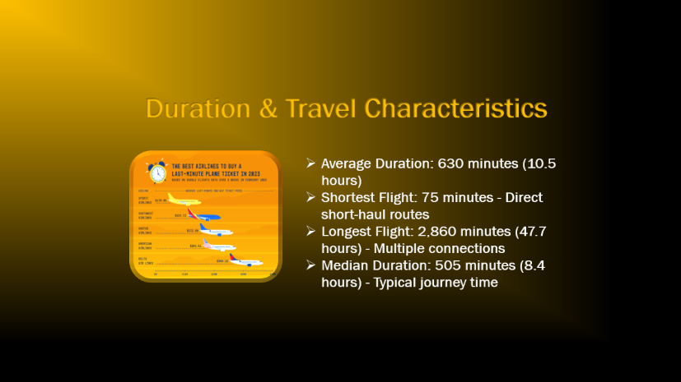

Slide 14

Pricing by Airline
Premium Services
Jet Airways Business: ₹58,359
Jet Airways: ₹11,599
Air India: ₹9,555
Budget/Economy
SpiceJet: ₹4,336
Air Asia: ₹5,594
IndiGo: ₹5,668

Slide 15
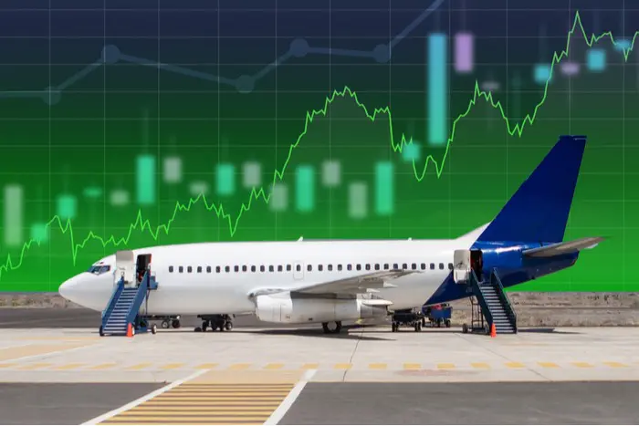
Price Impact : Number of Stops
0 Stops (Direct): ₹8,537 - Most affordable non-stop option
1 Stop: ₹9,283 - Moderate increase (9% premium)
2 Stops: ₹9,434 - Minimal additional cost
3+ Stops: ₹9,671 - Highest prices for connecting flights

Slide 16





Pricing by Departure Time
Departure Patterns
Evening: ₹9,823 (Highest)
Afternoon: ₹9,439
Morning: ₹8,380 (Best prices)
Key Insight
Evening departures are premium-priced. Morning flights offer best deals. Night flights show moderate pricing patterns.
Evening: ₹9,823 (Highest)
Afternoon: ₹9,439
Morning: ₹8,380 (Best prices)

Slide 17
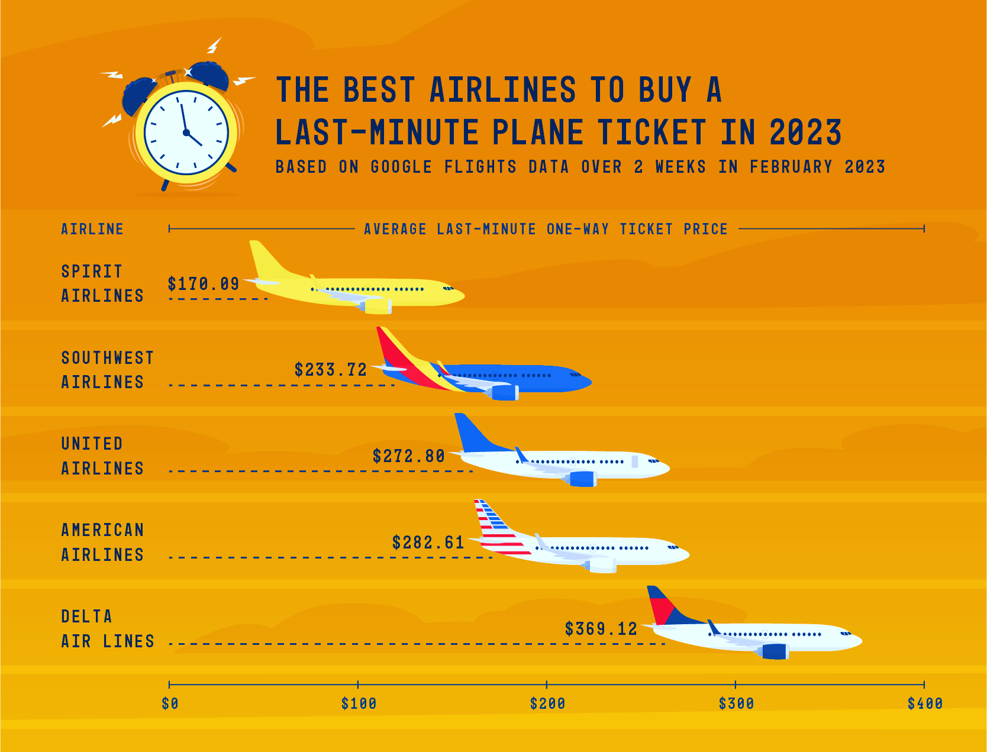
Duration & Travel Characteristics
Average Duration: 630 minutes (10.5 hours)
Shortest Flight: 75 minutes - Direct short-haul routes
Longest Flight: 2,860 minutes (47.7 hours) - Multiple connections
Median Duration: 505 minutes (8.4 hours) - Typical journey time

Slide 18

Key Findings & Patterns
Budget carriers (SpiceJet, Air Asia, IndiGo) offer 40%+ savings vs full-service
Delhi-Cochin dominates dataset with 41.5% of all flights
Morning departures provide best value (up to 15% cheaper)
Direct flights cost only 8% more than connecting options
INSIGHTS
RECOMMENDATIONS
CONCLUSION

Slide 19

Business Recommendations
Develop price prediction models for revenue optimization
Identify booking trends and demand patterns by route
Analyze airline competitiveness and pricing strategies
Target budget-conscious travelers with morning flight promotions
INSIGHTS
RECOMMENDATIONS
CONCLUSION

Slide 20
FINAL CONCLUSION
Clear Market Segmentation : The Indian flight market exhibits distinct pricing tiers with budget carriers (₹4,300-5,700) offering 40%+ savings versus premium carriers (₹11,600-58,359), indicating strong market differentiation based on service tier and airline positioning.
Route-Driven Demand : Delhi-Cochin's dominance with 41.5% of flights demonstrates a highly concentrated market where specific routes command premium volumes, suggesting strategic importance for revenue management and capacity planning.
Temporal Pricing Advantage : Morning departures are 15% cheaper (₹8,380) compared to evening flights (₹9,823), presenting clear arbitrage opportunities for price-sensitive travelers and dynamic pricing strategies for airlines.
Minimal Connectivity Premium: Direct flights cost only 8% more than multi-stop options, challenging the assumption that convenience commands high premiums and making connecting flights viable for budget optimization.
ML-Ready Data Patterns: The dataset exhibits strong predictive signals across airline type, departure timing, route selection, and number of stops, making it ideal for building machine learning models for revenue forecasting, demand prediction, and personalized pricing strategies in the aviation industry.
INSIGHTS
RECOMMENDATIONS
CONCLUSION

